Slide 1


Huazhong University of Science and Technology
The Department of Electronics and Information Engineering
Electronic Circuit Analysis and Design
Dr. Tianping Deng
Email: dengtp@hust.edu.cn

Slide 2
Contents
PART 1 SEMICONDUCTOR DEVICES AND BASIC APPLICATIONS
Chapter 1 Semiconductor Materials and Diodes
Chapter 2 Diode Circuits
Chapter 3 The Field-Effect Transistor
Chapter 4 Basic FET Amplifiers
Chapter 5 The Bipolar Junction Transistor
Chapter 6 Basic BJT Amplifiers
Chapter 7 Frequency Response
Chapter 8 Output Stages and Power Amplifiers
PART 2 ANALOG ELECTRONICS
Chapter 9 Ideal Operational Amplifiers and Op-Amp Circuits
Chapter 10 Integrated Circuit Biasing and Active Loads
Chapter 11 Differential and Multistage Amplifiers
Chapter 12 Feedback and Stability
Chapter 13 Operational Amplifier Circuits
Chapter 14 Nonideal Effects in Operational Amplifier Circuits
Chapter 15 Applications and Design of Integrated Circuits
Diode
MOSFET
BJT

Slide 3
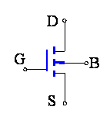
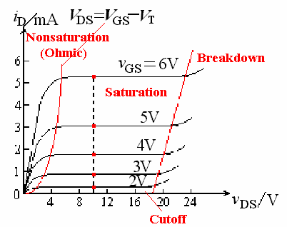
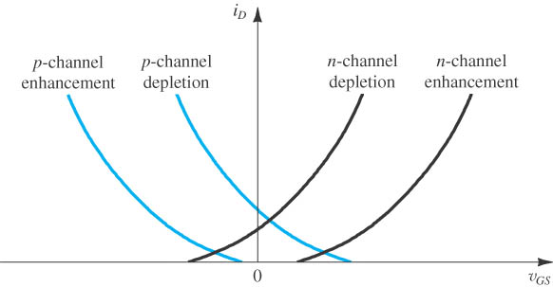
Overview
For chapter 3 and chapter 4:
1、MOSFET structure，feature, i-v characteristic

Slide 4
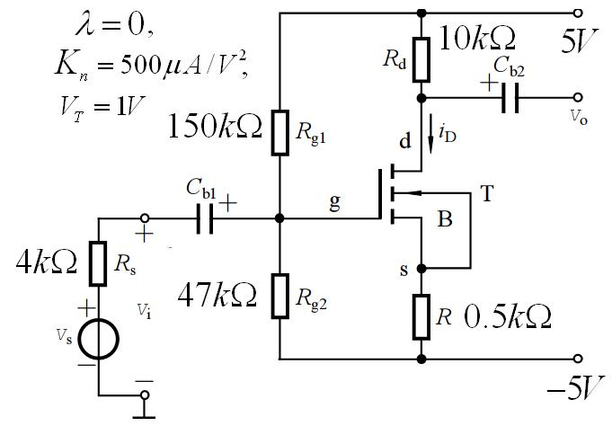
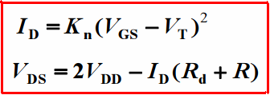
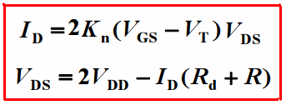
Overview
2、DC analysis
Calculate V_{GS} 、 I_{D} 、 V_{DS}
A、For enhancement NMOS
Saturation region
Non-saturation region

Slide 5
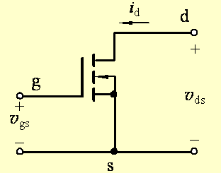
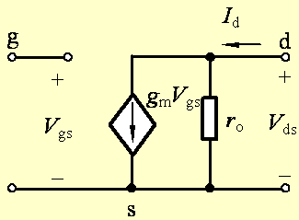
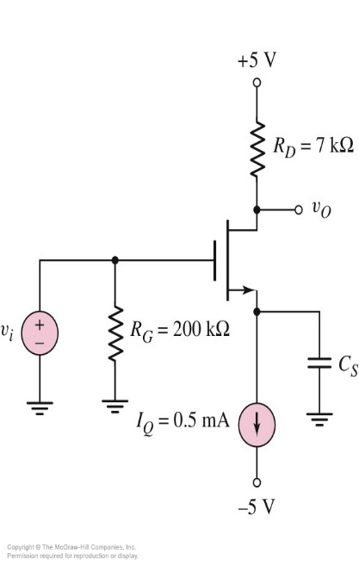
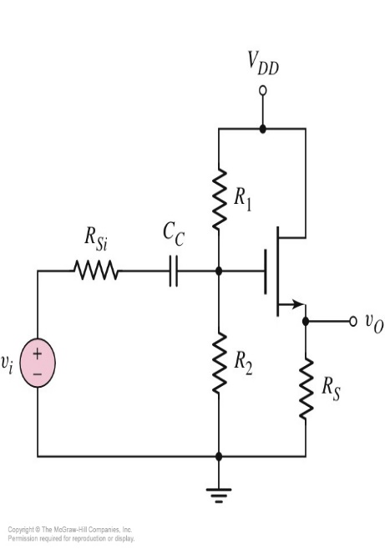
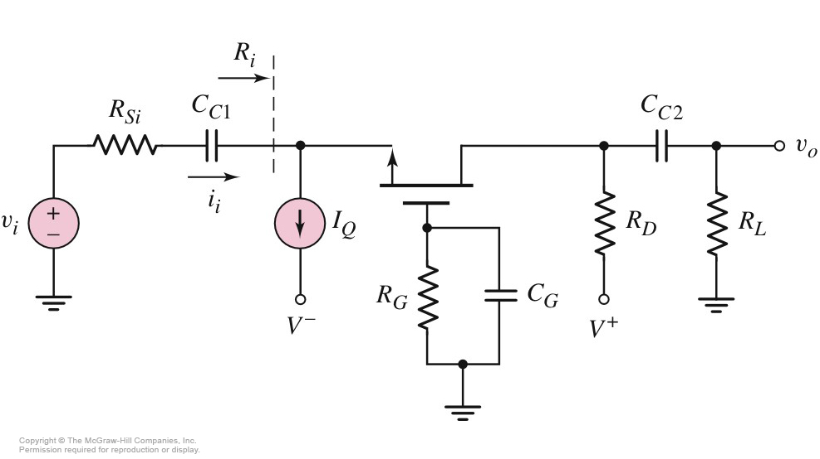
Overview
3、AC analysis

Slide 6
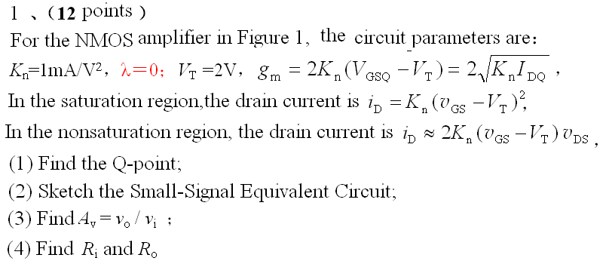
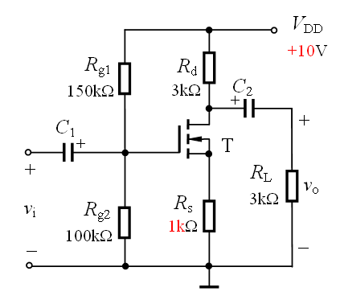


Slide 7
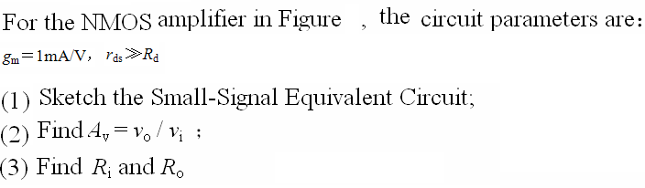
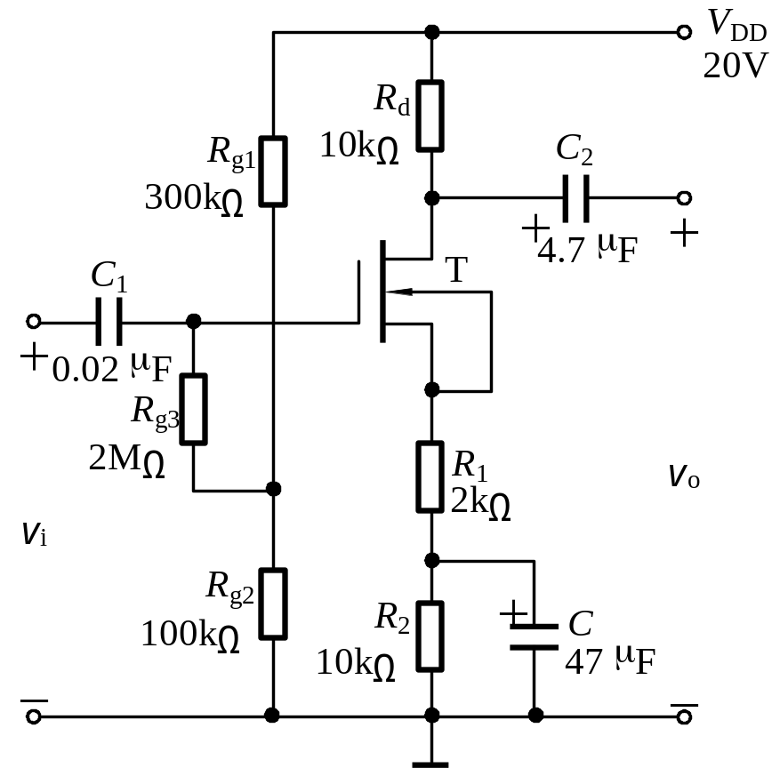

Slide 8
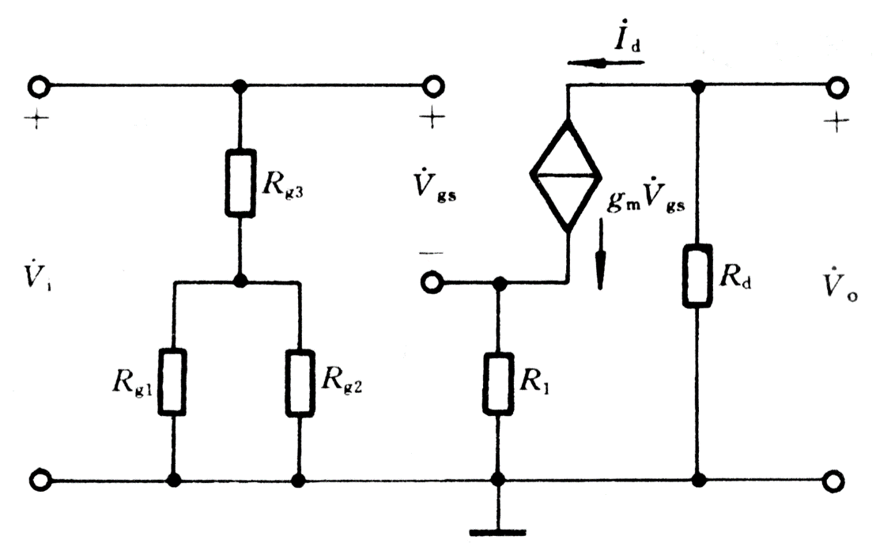

Slide 9
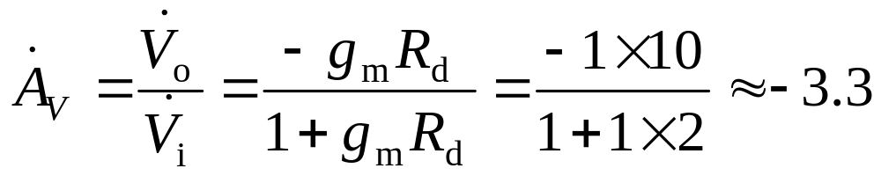
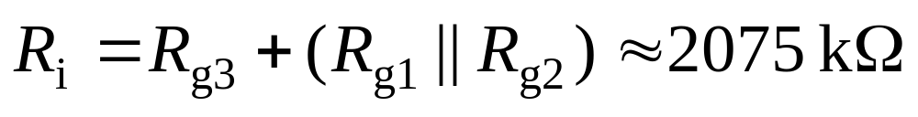

Slide 10
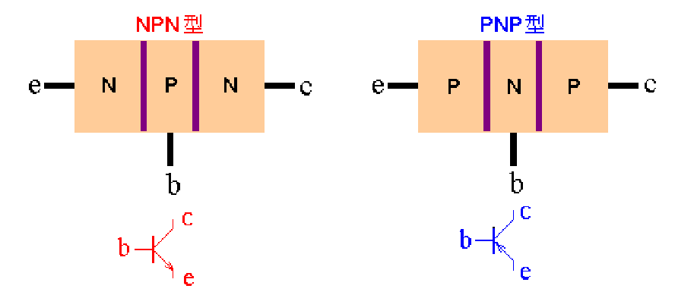
Overview
Three regions:
Three
terminals
Two pn junctions:

Slide 11
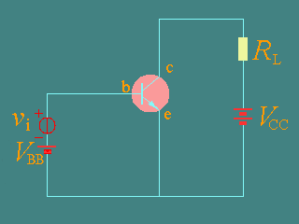
The output Characteristic of CE
i_{C}=f(v_{CE})⏐ _{iB=const}

Slide 12
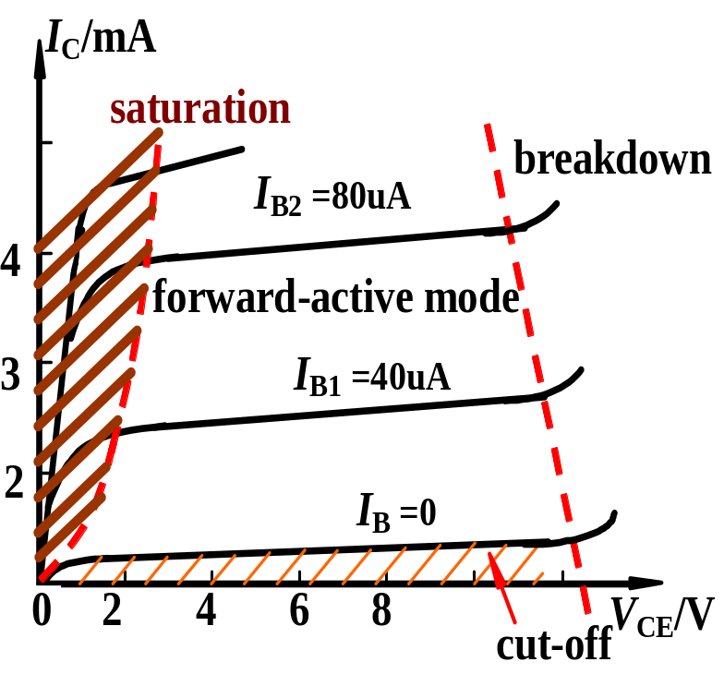
Output characteristic of CE (Transistor characteristic)
i_{C}=f(v_{CE})⏐ _{iB=const}
Four regions for characteristic
Saturation：i_{C} is controlled by v_{CE}, i_{C} increases rapidly as v_{CE} increases, and v_{CE}＜0.7V (Silicon)。B-E is forward biased, B-C is forward biased, too, or voltage of reverse biased is very small.

Slide 13
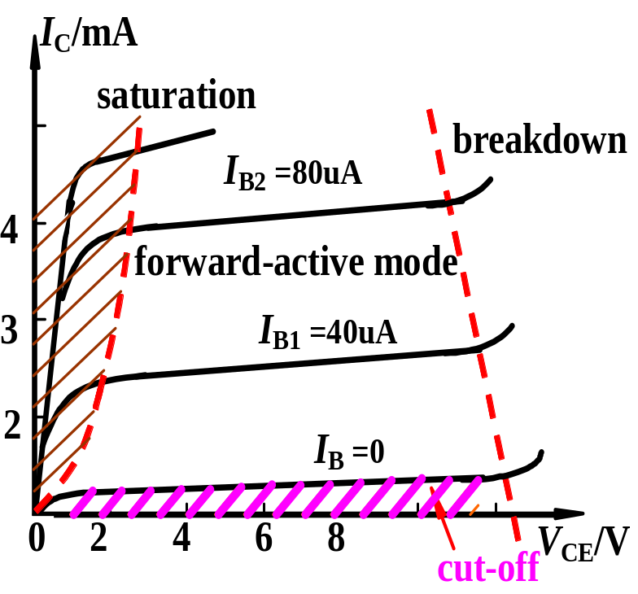
Output characteristic of CE (Transistor characteristic)
i_{C}=f(v_{CE})⏐ _{iB=const}
Four regions for characteristic
Cut-off：i_{C} is nearly zero，Cut-off region is under i_{B}=0。V_{BE} < V_{th} (turn in voltage), B-C is reverse biased。

Slide 14
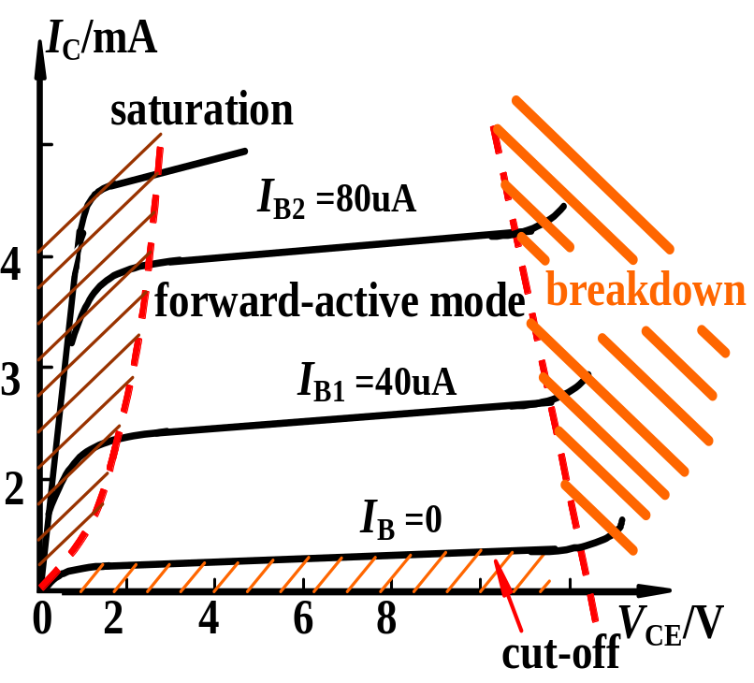
Output characteristic of CE (Transistor characteristic)
i_{C}=f(v_{CE})⏐ _{iB=const}
Four regions for characteristic
Breakdown: Reverse-bias voltage of B-C increases too much, B-C junction begin to breakdown.

Slide 15
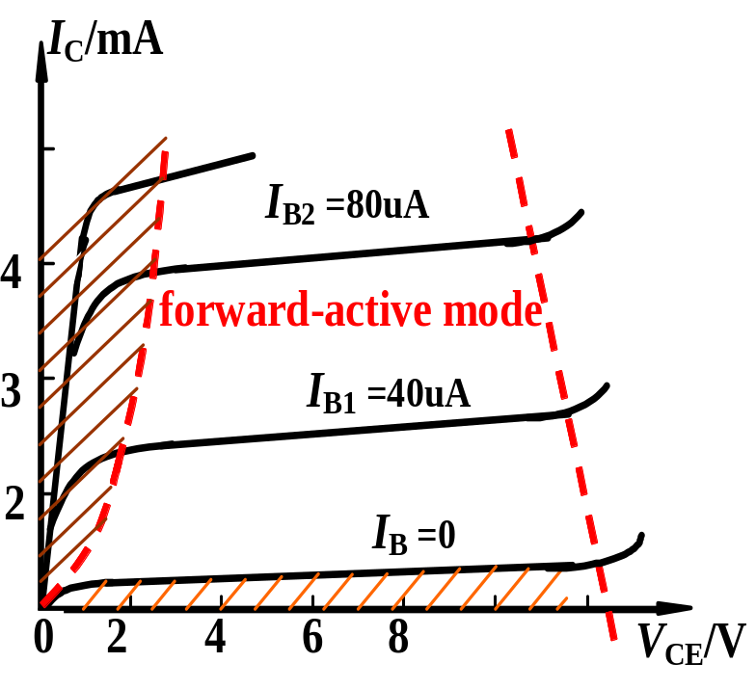

Output characteristic of CE (Transistor characteristic)
i_{C}=f(v_{CE})⏐ _{iB=const}
Four regions for characteristic
Forward-active mode： i_{C} and i_{B} are related by i_{C} = i_{B}. Curves are parallel and equidistance. B-E is forward biased, B-C is reverse biased.

Slide 16
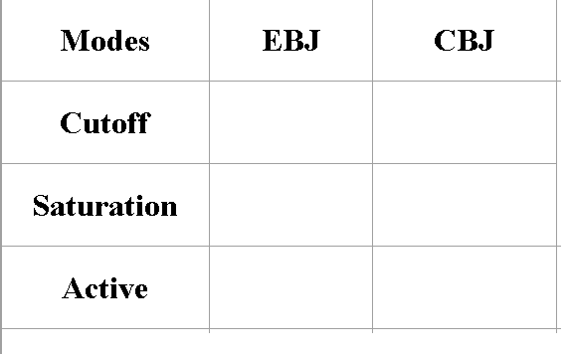


Overview
Modes of Operation

Slide 17
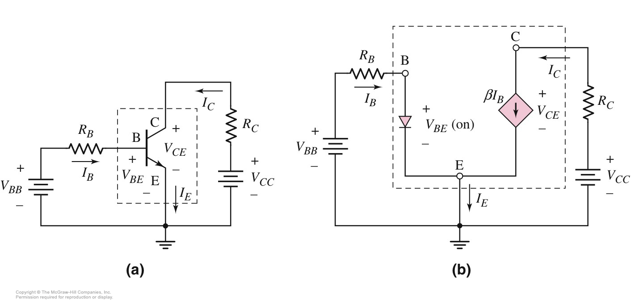

Overview
For chapter 5 and chapter 6
Common Emitter Circuit

Slide 18
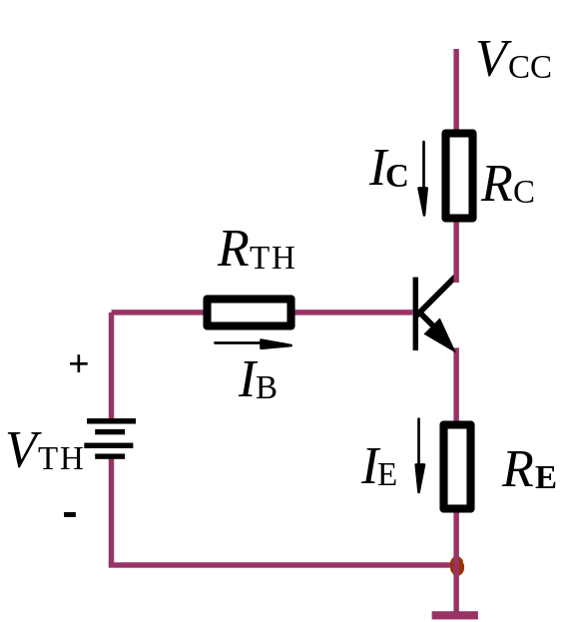
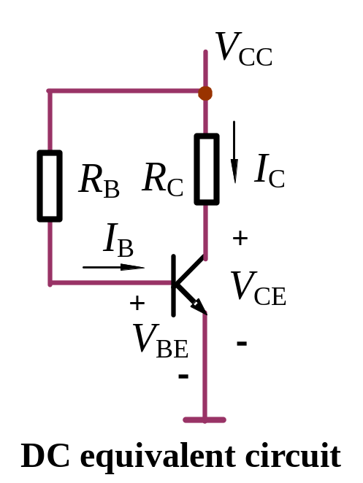
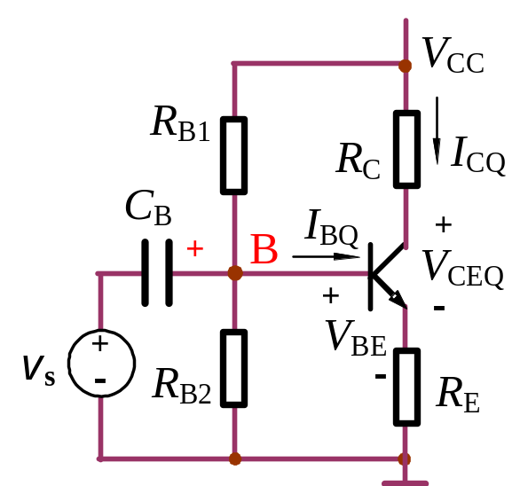

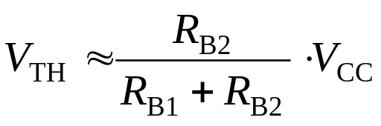
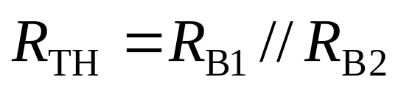
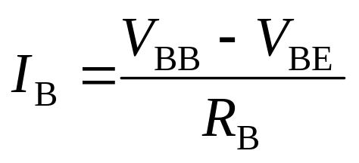
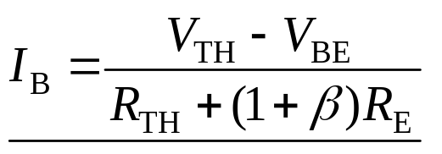
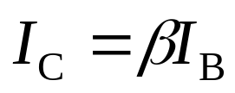

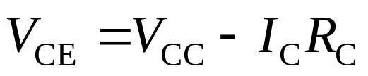
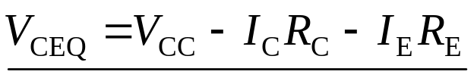
Overview
For chapter 5 and chapter 6

Slide 19

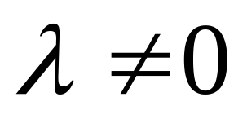
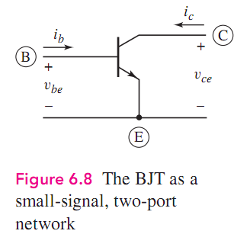
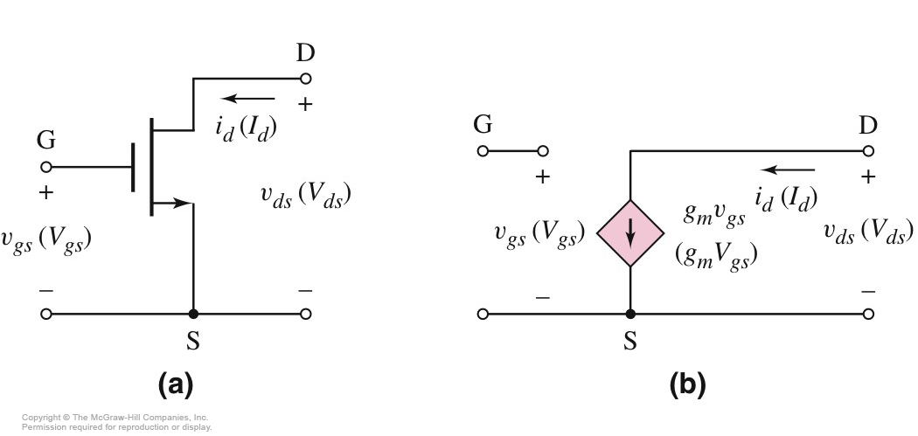

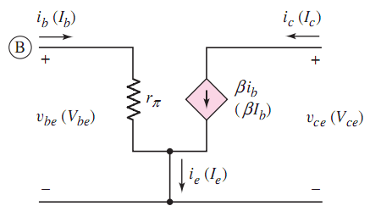

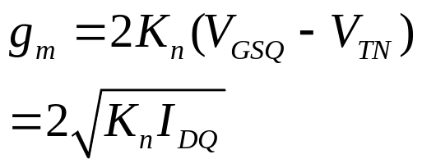
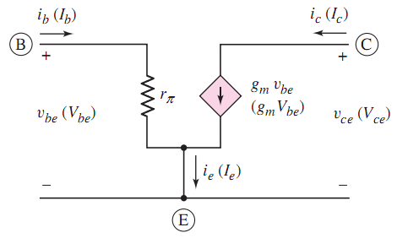
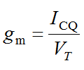

Slide 20
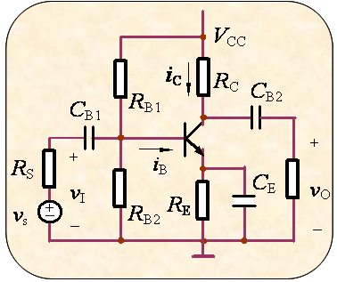
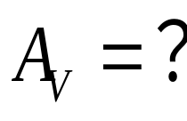
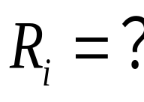
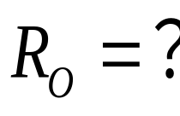

Slide 21
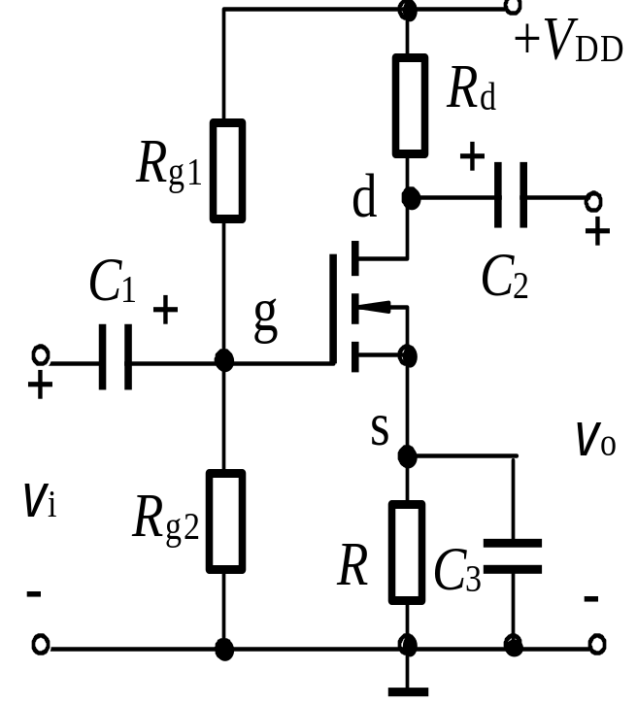
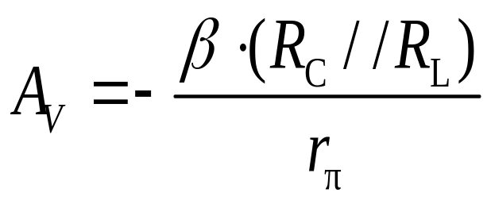
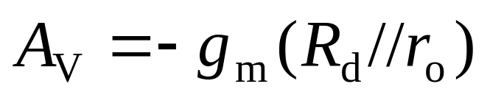





Slide 22







Large
Small
Small

Slide 23


CH3&4 5&6
BJT
FET
CE
CS
Inverting Amplifier
CC
CD
voltage follower
CB
CG
current follower

Slide 24
DC Analysis
Q－point
DC biasing

Slide 25
AC Analysis
A_{V}，R_{i}，R_{o}
AC Performance

Slide 26

The Three Basic Amplifier Configuration:

Slide 27





The Three Basic Amplifier Configuration:

Slide 28


The Three Basic Amplifier Configuration:

Slide 29






You need to complete and submit your answer in 30 minutes.
Closed book！

Slide 30


Slide 31

6.9 Multistage Amplifiers (P440)
(1) The Reason of Using Multistage Circuit
A single transistor amplifier will not be able to meet the combined specifications of a given amplification factor, input resistance, and output resistance.
(2) Cascade Configuration
3 circuits are connected in series, or cascaded. Each circuit can be CE, CC, or CB configuration

Slide 32
6.9 Multistage Amplifiers(P440)
(3) Loading effect
E.g. R_{i2} is the load of stage 1.
R_{i2} = R_{L1}
R_{o1} = R_{S2}

Slide 33

R_{i2}

Slide 34



R_{i2}

Slide 35

R_{i}

Slide 36


Slide 37
Questions
and
Answers

